Slide 1
Entity-Relationship Model
Md. Ariful Islam Khandaker
Assistant Professor, IICT
Khulna University of Engineering & Technology (KUET)

Slide 2
Outline
Entity Sets
Relationship Sets
Design Issues
Mapping Constraints
Keys
E-R Diagram
Extended E-R Features
Design of an E-R Database Schema
Reduction of an E-R Schema to Tables

Slide 3
Entity Sets
A database can be modeled as:
  a collection of entities,
  relationship among entities.
Entity Sets have 3 parts-
1. Attributes 2. Entity 3. Entity Set
An entity is an object that exists and is distinguishable from other objects.
Example: specific person, company, event, plant
Entities have attributes. Attribute is called fact or descriptive value. Naturally it is individual part of entity.
Example: people have names and addresses
An entity set is a set of entities of the same type that share the same properties.
Example: set of all persons, companies, trees, holidays

Slide 4
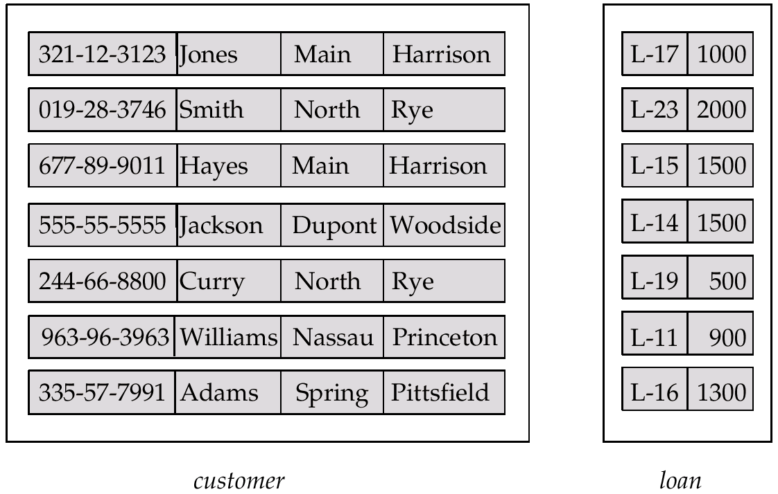
Entity Sets customer and loan
customer-id customer- customer- customer- loan- amount
name street city number

Slide 5
Attributes
An entity is represented by a set of attributes, that is descriptive properties possessed by all members of an entity set.
Example:
customer = (customer-id, customer-name, customer-street, customer-city)
Domain – the set of permitted values for each attribute or value set. Example- sex is an attribute and domain is male and female.
Attribute types:
  Simple and composite attributes.-simple attributes are not divided into subparts. Composite attributes can be divided into subparts. For example, an attribute name could be divided into first-name, middle-name, last-name.
  Single-valued and multi-valued attributes-attributes that take only one value exactly are called single-valued and attributes that can take several values are called multi-valued attribute. Consider phone-number is an attribute of customer entity set. A customer has zero, one, or several phone numbers.
  Derived attributes- The value for this type of attribute can be derived from the values of other related attributes or entities. Suppose customer entity set has two attributes- age, date-of-birth. Here age can be calculated from date-of-birth attribute, so age is derived attribute.

Slide 6

Composite Attributes
A relationship is an association among several entities
Example:
Hayes depositor A-102
customer entity relationship set account entity
A relationship set is a set of relationships of the same type. Formally it is a mathematical relation among n ≥ 2 entities, each taken from entity sets
{(e₁, e₂, … e_{n}) | e₁ ∈ E₁, e₂ ∈ E₂, …, e_{n} ∈ E_{n}}
where (e₁, e₂, …, e_{n}) is a relationship, E is entity, R is relationship set.
  Example: (Hayes, A-102) ∈ depositor

Slide 7


Relationship Set borrower
Recursive Relationship set- When same entity set participates in a relationship set more than once, in different roles, this type of relationship set is called recursive relationship set.

Slide 8

Relationship Sets (Cont.)
A relationship may also have attributes called descriptive attributes.
For instance, the depositor relationship set between entity sets customer and account may have the attribute access-date

Slide 9
Degree of a Relationship Set
Refers to number of entity sets that participate in a relationship set.
Relationship sets that involve two entity sets are binary (or degree two). Generally, most relationship sets in a database system are binary.
Relationship sets may involve more than two entity sets.
  E.g. Suppose employees of a bank may have jobs (responsibilities) at multiple branches, with different jobs at different branches. Then there is a ternary relationship set between entity sets employee, job and branch
Relationships between more than two entity sets are rare. Most relationships are binary. (More on this later.)

Slide 10
Mapping Cardinalities
Mapping cardinalities, or cardinality ratios, express the number of entities to which another entity can be associated via a relationship set.
Most useful in describing binary relationship sets.
For a binary relationship set the mapping cardinality must be one of the following types:
  One to one- An entity in A is associated with at most one entity in B, and an entity in B is associated with at most one entity in A.
  One to many- An entity in A is associated with any number of entities in B. An entity in B can be associated with at most one entity in A.
  Many to one- An entity in A associated with at most one entity in B. An entity in B can be associated with any number of entities in A.
  Many to many- An entity in A is associated with any number of entities in B, and an entity in B is associated with any number of entities in A.

Slide 11

Mapping Cardinalities
One to one
One to many
Note: Some elements in A and B may not be mapped to any
elements in the other set

Slide 12

Mapping Cardinalities
Many to one
Many to many
Note: Some elements in A and B may not be mapped to any
elements in the other set

Slide 13

E-R Diagrams
Rectangles represent entity sets.
Diamonds represent relationship sets.
Lines link attributes to entity sets and entity sets to relationship sets.
Ellipses represent attributes
  Double ellipses represent multivalued attributes.
  Dashed ellipses denote derived attributes.
Underline indicates primary key attributes (will study later).
Double rectangles represent weak entity sets.
Double lines which indicate total participation of an entity in a relationship set.

Slide 14

E-R Diagram With Composite, Multivalued, and Derived Attributes

Slide 15
Roles
Role- The function that an entity plays in a relationship is called that entity’s role.
Entity sets of a relationship need not be distinct
The labels “manager” and “worker” are called roles; they specify how employee entities interact via the works-for relationship set.
Roles are indicated in E-R diagrams by labeling the lines that connect diamonds to rectangles.
Role labels are optional, and are used to clarify semantics of the relationship

Slide 16

Cardinality Constraints
We express cardinality constraints by drawing either a directed line (→), signifying “one,” or an undirected line (—), signifying “many,” between the relationship set and the entity set.
E.g.: One-to-one relationship:
  A customer is associated with at most one loan via the relationship borrower
  A loan is associated with at most one customer via borrower

Slide 17
One-To-Many Relationship
In the one-to-many relationship a loan is associated with at most one customer via borrower, a customer is associated with several (including 0) loans via borrower

Slide 18
Many-To-One Relationships
In a many-to-one relationship a loan is associated with several (including 0) customers via borrower, a customer is associated with at most one loan via borrower

Slide 19
Many-To-Many Relationship
A customer is associated with several (possibly 0) loans via borrower
A loan is associated with several (possibly 0) customers via borrower

Slide 20
Some Exercise
Draw ERD showing the degree of relationship, membership class and convert the ERD into table or tables of the followings: -
A department employs many persons
A person is employed by, at most one department
A teacher teaches exactly one course
A course may or may not be taught by one teacher.
An author may write many books
A book may be written by many authors.
A manager manages, at most, one department
A department is managed by exactly one manager.
A teacher teaches exactly one course
A course is taught by exactly one teacher.

Slide 21

Participation of an Entity Set in a Relationship Set
Total participation (indicated by double line): every entity in the entity set participates in at least one relationship in the relationship set
  E.g. participation of loan in borrower is total
    every loan must have a customer associated to it via borrower
Partial participation: some entities may not participate in any relationship in the relationship set
  E.g. participation of customer in borrower is partial

Slide 22
Keys
Keys – We must have a way to specify how entities within a given entity set are distinguished. A key allows us to identify a set of attributes that suffice to distinguish entities from each other.
A super key is a set of one or more attributes that, taken collectively, allow us to identify uniquely an entity in the entity set.
For example- customer-id attribute of customer entity set is sufficient to distinguish one customer from another. So customer-id is a super key. Again, the combination of customer-name and customer-id is also super key of that entity set.
A candidate key of an entity set is a minimal set of super key.
Here both {customer-id} and {customer-name, customer-street} are candidate keys. Although the attributes customer-id and customer-name together can distinguish customer entities, their combination does not form a candidate key, since the attribute customer-id alone is a candidate key.
A primary key is used to denote a candidate key that is chosen by the database designer as the principal means of identifying entities within an entity set.

Slide 23

E-R Diagram with a Ternary Relationship

Slide 24
Weak Entity Sets
An entity set that does not have a primary key is referred to as a weak entity set.
The existence of a weak entity set depends on the existence of a identifying entity set
  it must relate to the identifying entity set via a total, one-to-many relationship set from the identifying to the weak entity set
  Identifying relationship depicted using a double diamond
The discriminator (or partial key) of a weak entity set is the set of attributes that distinguishes among all the entities of a weak entity set.
The primary key of a weak entity set is formed by the primary key of the strong entity set on which the weak entity set is existence dependent, plus the weak entity set’s discriminator.

Slide 25

Weak Entity Sets (Cont.)
We depict a weak entity set by double rectangles.
We underline the discriminator of a weak entity set with a dashed line.
payment-number – discriminator of the payment entity set
Primary key for payment – (loan-number, payment-number)

Slide 26
Specialization
Top-down design process; we designate subgroupings within an entity set that are distinctive from other entities in the set.
These subgroupings become lower-level entity sets that have attributes or participate in relationships that do not apply to the higher-level entity set.
Depicted by a triangle component labeled ISA (E.g. customer “is a” person).
Attribute inheritance – a lower-level entity set inherits all the attributes and relationship participation of the higher-level entity set to which it is linked.

Slide 27

Specialization Example

Slide 28
Generalization
A bottom-up design process – combine a number of entity sets that share the same features into a higher-level entity set.
Specialization and generalization are simple inversions of each other; they are represented in an E-R diagram in the same way.
The terms specialization and generalization are used interchangeably.

Slide 29
E-R Design Decisions
The use of an attribute or entity set to represent an object.
Whether a real-world concept is best expressed by an entity set or a relationship set.
The use of a ternary relationship versus a pair of binary relationships.
The use of a strong or weak entity set.
The use of specialization/generalization – contributes to modularity in the design.
The use of aggregation – can treat the aggregate entity set as a single unit without concern for the details of its internal structure.

Slide 30
Step by step banking database design
Data Requirements
The bank is organized into branches. Each branch is locate in a particular city and is designed by a unique name. The bank monitors the assets of each branch.
Bank customers are identified by customer_id. The bank store each customer’s name and the street and city where the customer lives. Customers may have accounts and can take out loans. A customer may be associated with a particular banker, who may act as a loan officer or personal banker for that customer.
Bank employees are identified by their employee_id values. The bank administration stores the name and telephone number of each employee, the names of the employee’s dependents, and the employee_id number of the employee’s manager. The bank also keeps track of the employee’s start date and, thus, length of employment.

Slide 31
Step by step banking database design
Data Requirements
The bank offers two types of accounts- savings and checking accounts. Accounts can be held by more than one customer, and a customer can have more than one account. Each account is assigned a unique account number. The bank maintains a record of each account’s balance and the most recent date on which the account was accessed by each customer holding the account. In addition, each savings account has an interest rate and overdrafts are recorded for each checking account.
A loan originates at a particular branch and can be held by one or more customers. A loan is identified by a unique loan number. For each loan, the bank keeps track of the loan amount and the loan payments. Although a loan payment number does not uniquely identify a particular payment among those for all the bank’s loans, a payment number does identify a particular payment for a specific loan. The date and amount are recorded for each payment.

Slide 32
Step by step banking database design
Entity Sets Designation
The branch entity set, with attributes branch_name, brach_city, and assets.
The customer entity set, with attributes customer_id, customer_name, customer_street, and customer_city. A possible additional attribute is banker_name
The employee entity set, with attributes employee_id, employee_name, telephone_number, salary, and manager. Additional descriptive features are the multi-valued attribute dependent_name, the base attribute start_date, and the derived attribute employment_length.
Two account entity sets-savings_account and checking_account- with common attributes of account_number, and balance. Savings account has attribute interest_rate and checking account has the attribute overdraft.

Slide 33
Step by step banking database design
Entity Sets Designation
The loan entity set, with the attributes loan_number, amount and originating_branch.
The weak entity set loan_payment, with attirbutes payment_number, payment_date, and payment_amount.
Relationship Sets Designation
borrower- a many-to-many relationship set between customer and laon.
loan_branch- a many-to-many relationship.
loan_payment- a one-to-many relationship from loan to payment.
depositor – with relationship attribute access_date, a many-to-many relationship set between customer and account.

Slide 34
Step by step banking database design
Relationship Sets Designation
cust-banker- with relationship attribute type, a many-to-one relationship set expressing that a customer can be advised by a bank employee, and that a bank employee can advise one or more customers.
works_for- a relationship set between employee entities with role indicators manager and worker.

Slide 35

E-R Diagram for a Banking Enterprise

Slide 36

Summary of Symbols Used in E-R Notation

Slide 37
Summary of Symbols (Cont.)

Slide 38

Alternative E-R Notations

Slide 39
Database Practice
Construct an E-R diagram for a university registrar’s office maintains data about the following entities:
(a) courses, including number, title, credits, syllabus and prerequisites;
(b) course offerings, including course number, year, semester, section no , time and room.
(c) students, including student-id, name, and program; and
(d) instructors including identification number, name, department and title.

Slide 40
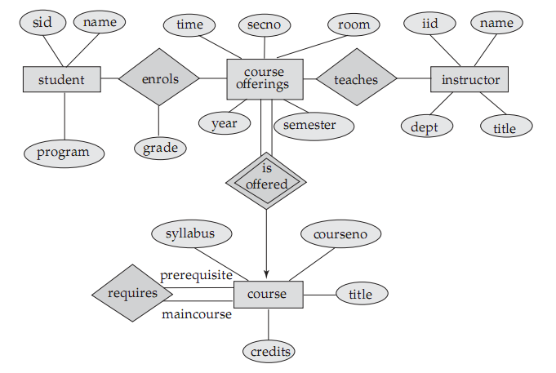
University Database

Slide 41
Reduction of an E-R Schema to Tables
Primary keys allow entity sets and relationship sets to be expressed uniformly as tables which represent the contents of the database.
A database which conforms to an E-R diagram can be represented by a collection of tables.
For each entity set and relationship set there is a unique table which is assigned the name of the corresponding entity set or relationship set.
Each table has a number of columns (generally corresponding to attributes), which have unique names.
Converting an E-R diagram to a table format is the basis for deriving a relational database design from an E-R diagram.

Slide 42
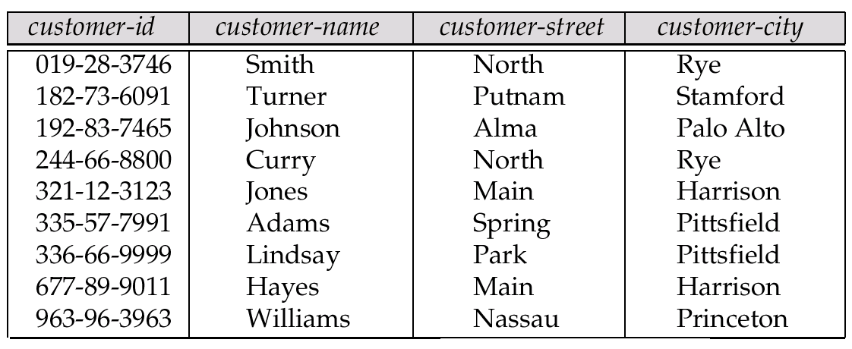
Representing Entity Sets as Tables
A strong entity set reduces to a table with the same attributes.
All attributes should be turned into columns

Slide 43
Composite and Multivalued Attributes
Composite attributes are flattened out by creating a separate attribute for each component attribute
  E.g. given entity set customer with composite attribute name with component attributes first-name and last-name the table corresponding to the entity set has two attributes
  name.first-name and name.last-name
A multivalued attribute M of an entity E is represented by a separate table EM
  Table EM has attributes corresponding to the primary key of E and an attribute corresponding to multivalued attribute M
  E.g. Multivalued attribute dependent-names of employee is represented by a table
  employee-dependent-names( employee-id, dname)
  Each value of the multivalued attribute maps to a separate row of the table EM
    E.g., an employee entity with primary key John and
    dependents Johnson and Johndotir maps to two rows:
    (John, Johnson) and (John, Johndotir)

Slide 44
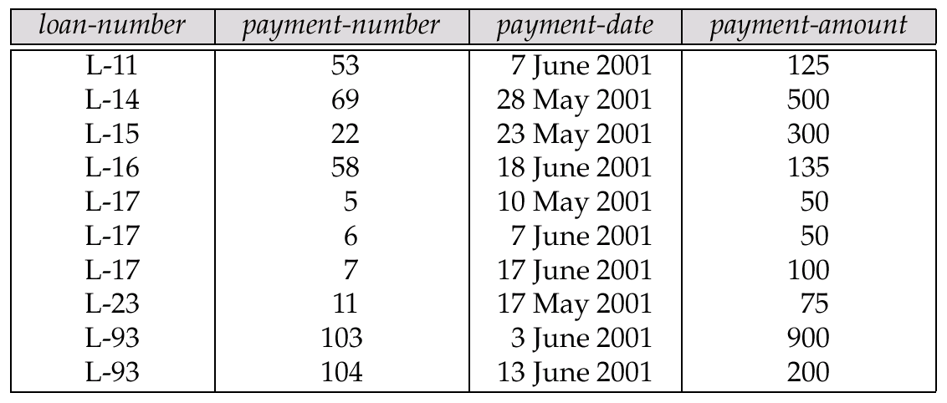
Representing Weak Entity Sets
A weak entity set becomes a table that includes a column for the primary key of the identifying strong entity set

Slide 45
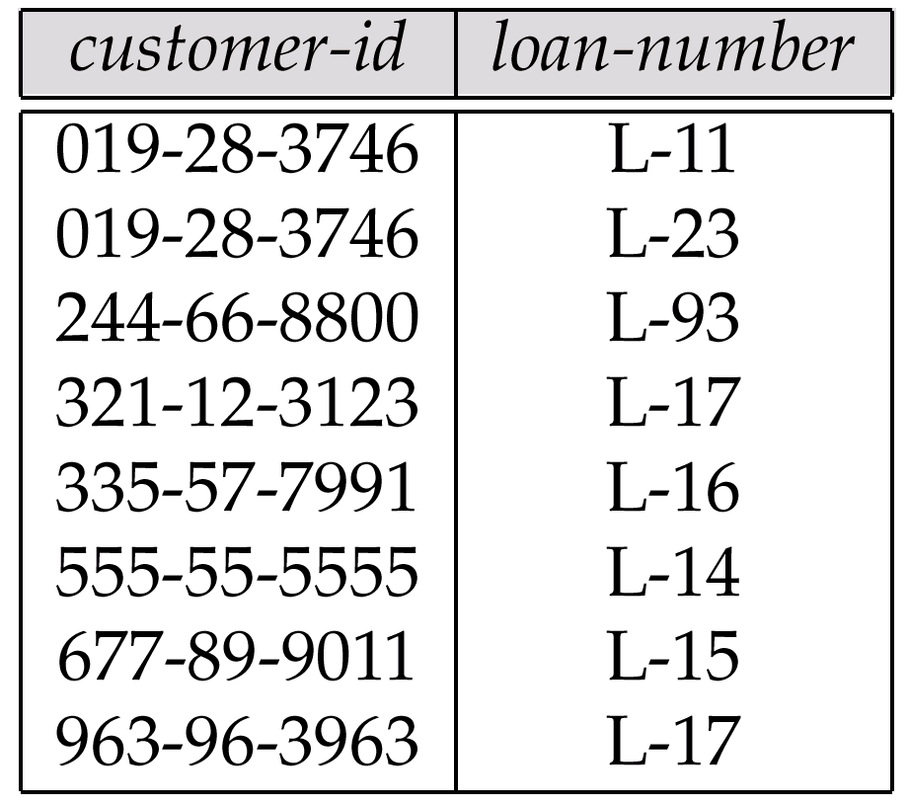
Representing Relationship Sets as Tables
A many-to-many relationship set is represented as a table with columns for the primary keys of the two participating entity sets, and any descriptive attributes of the relationship set.
E.g.: table for relationship set borrower

Slide 46

Redundancy of Tables
Many-to-one and one-to-many relationship sets that are total on the many-side can be represented by adding an extra attribute to the many side, containing the primary key of the one side
E.g.: Instead of creating a table for relationship account-branch, add an attribute branch to the entity set account

Slide 47
Redundancy of Tables (Cont.)
For one-to-one relationship sets, either side can be chosen to act as the “many” side
  That is, extra attribute can be added to either of the tables corresponding to the two entity sets
If participation is partial on the many side, replacing a table by an extra attribute in the relation corresponding to the “many” side could result in null values
The table corresponding to a relationship set linking a weak entity set to its identifying strong entity set is redundant.
  E.g. The payment table already contains the information that would appear in the loan-payment table (i.e., the columns loan-number and payment-number).

Slide 48
Representing Specialization as Tables
Method 1:
  Form a table for the higher level entity
  Form a table for each lower level entity set, include primary key of higher level entity set and local attributes
  table table attributes
  person name, street, city
  customer name, credit-rating
  employee name, salary
  Drawback: getting information about, e.g., employee requires accessing two tables

Slide 49
Representing Specialization as Tables (Cont.)
Method 2:
  Form a table for each entity set with all local and inherited attributes
  table table attributes
  person name, street, city
  customer name, street, city, credit-rating
  employee name, street, city, salary
  If specialization is total, no need to create table for generalized entity (person)
  Drawback: street and city may be stored redundantly for persons who are both customers and employees

Slide 50
Exercise
Construct an ER diagram for car-insurance company whose customers own one or more cars each. Each car has associated with it zero to any number of the recorded accidents.

Slide 51
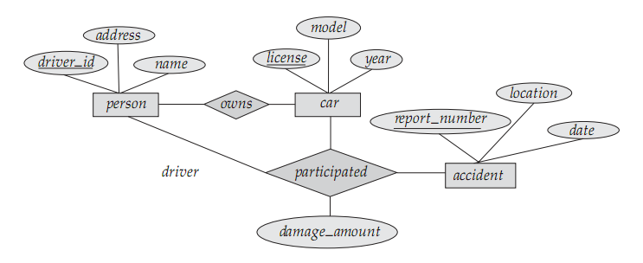
E-R Diagram for Car Insurance

Slide 52
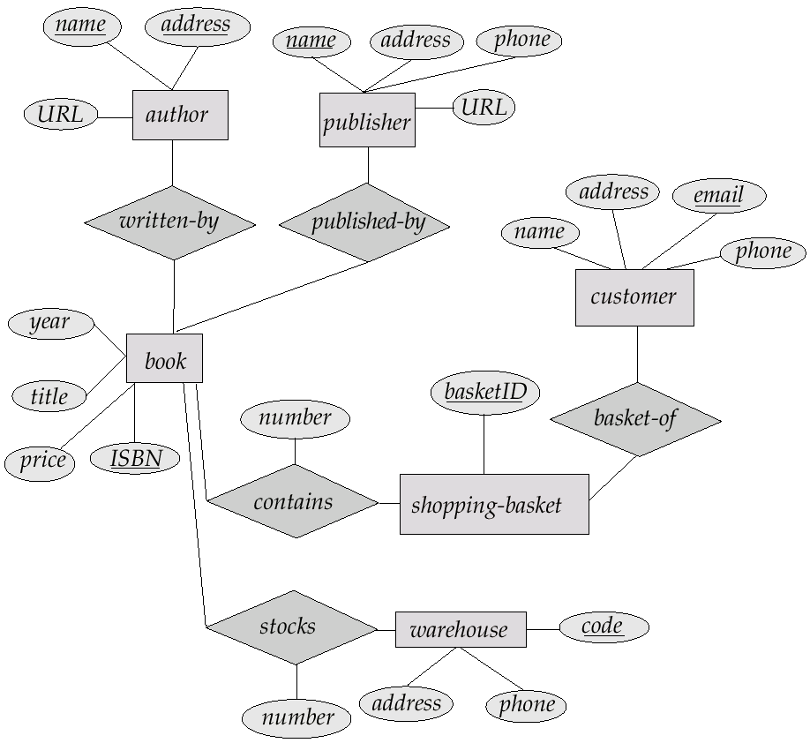
E-R Diagram for online Book shop

Slide 53
Thanks to all…

